Slide 1
Estimating Interaction Strengths in Ecological Communities Intro to MAR modeling
Eli Holmes
FISH 507 – Applied Time Series Analysis
5 March 2019

Slide 2
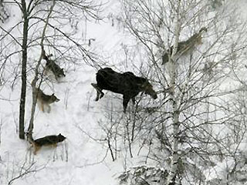
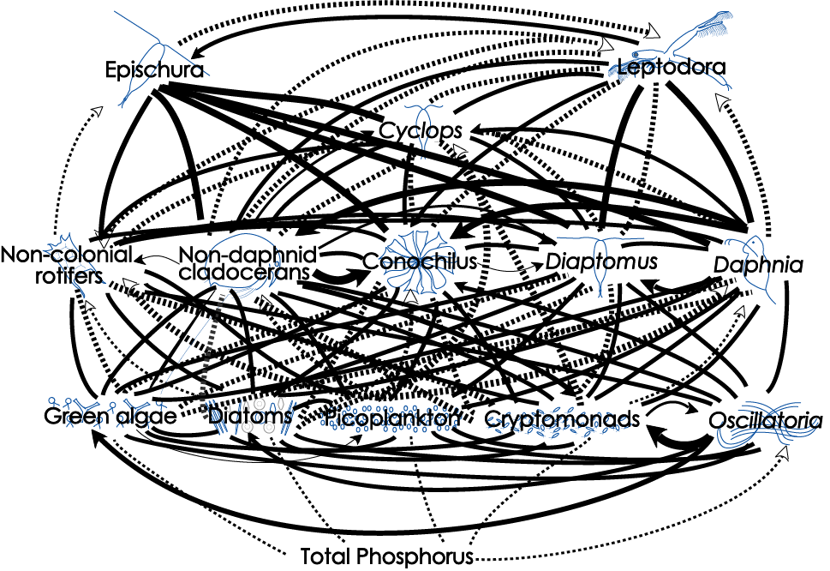
Topics
Univariate and multivariate Gompertz models
Example study: urchins and sea otters
Simple 2-spp model
2x2 B matrix
Large multivariate models
Big B matrices

Slide 3
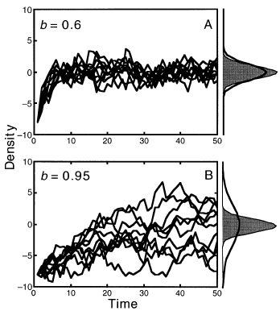
Mean-reverting processes
In lecture, I will talk about estimating mean-reversion in the context of density-dependence and species interactions, but mean-reverting stochastic processes are ubiquitous.
The Ornstein-Uhlenbeck process is the classic continuous time mean-reverting stochastic process. In the population dynamics literature, the Gompertz model is the classic discrete time mean-reverting process (although the Gompertz model also refers to a continuous time version).

Slide 4
Univariate Gompertz models

Slide 5
Density dependence
univariate discrete exponential growth not in log-space
univariate discrete density-dependent growth not in log-space
general
Specific type
The shape of f(n_t-1) determines the dynamics of the system:
stable or unstable equilibrium
Speed at which equilibrium is approached
Equilibrium level
Sensitivity to perturbations

Slide 6
Properties of this model
univariate discrete time deterministic Gompertz model
not in log-space
|b| < 1 “negative” density-dependence
b = 1, no density-dependence
|b| > 1, “positive” density-dependence (blows up)
The closer b is to 0, the stronger the density-dependence (stronger the pull back to the mean). If b=1, there is no “pull” back to the “mean” (the mean is not in fact defined for this case).

Slide 7
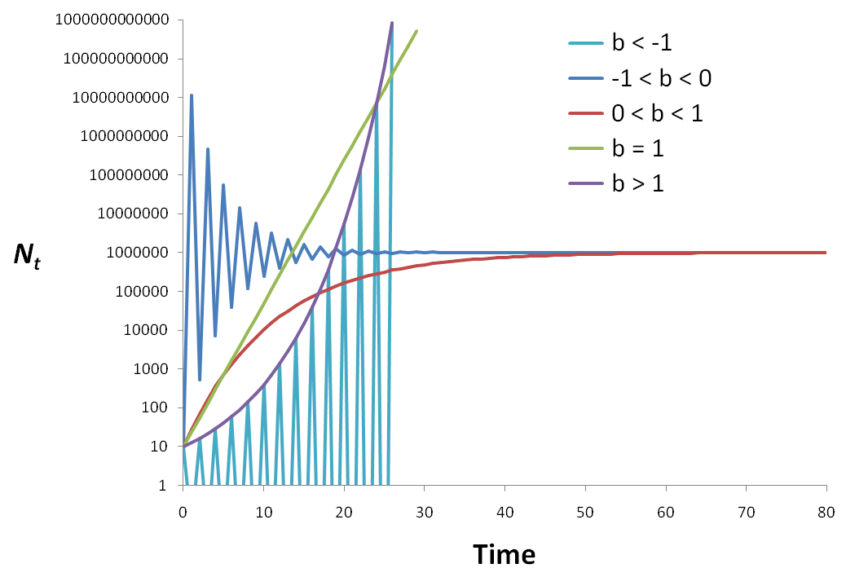
Examples of the Gompertz for different b
Our interest
u/(1-b)

Slide 8
Gompertz model written in log space is AR(1)
Taking the natural log of both sides
Substituting x_{t} for ln n_{t}
AR(1) minus the noise term

Slide 9
Equilibrium for the deterministic Gompertz model
the model reaches equilibrium at t = ∞, so we can write
And via some algebra, we arrive at:
(provided b ≠ 1)
The equilibrium is a function of BOTH u and b.
This is rather unfortunate.

Slide 10
Add stochasticity (process error)
Adding stochasticity yields a univariate, lag-1 autoregressive or “AR(1)” process:
If |b| < 1, the process is “stationary”
If b = 1, the process is a “random walk” & “non-stationary”
Known as the discrete-time Ornstein-Uhlenbeck process in physics but as Gompertz or stochastic Gompertz model in population dynamics.

Slide 11
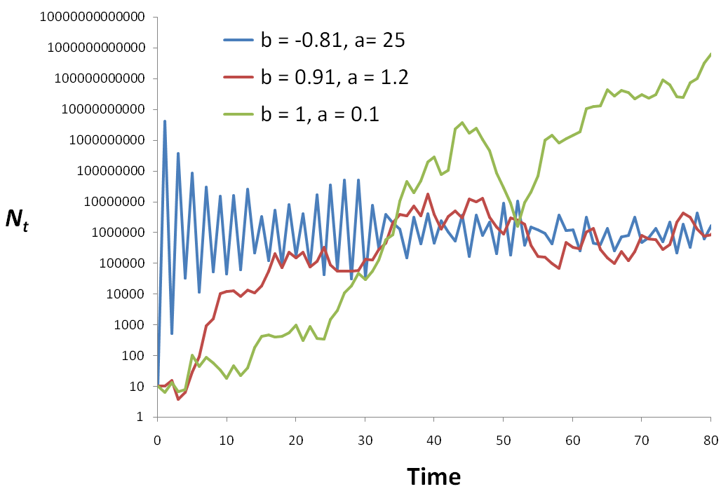
Example realizations
random walk
b=1
2-pt oscillation
u/(1-b)

Slide 12
Equilibrium for the stochastic Gompertz process
It has a stationary distribution
probability distribution of X_{t} as t → ∞
given |b| < 1
Normally distributed with
mean μ∞ and variance υ∞
Fig. 1 - Ives et al. (2003)

Slide 13
Properties of the stationary distribution
Assuming |b| < 1 (i.e. a stationary process)
mean
(provided b ≠ 1)
variance

Slide 14
Main properties
Basic features of the Gompertz process
Mean reverting, aka density-dependent
Stationary, so it fluctuates around a mean
Point equilibrium as opposed to a cycle equilibrium like Lotka-Volterra (Lynx & hare) models you studied (maybe) in Ecology 101
Can be seen as a locally linear approximation of other types of density-dependent interaction models
“locally linear” is jargon for “only holds for sure if x doesn’t change too much”. In our case, x = log(n) = log abundance.
S. E. Hampton, NCEAS, UCSB, hampton@nceas.ucsb.edu, 7 July 2007

Slide 15
observation error is known a problem obs error = spurious density-dependence
2010
2008

Slide 16
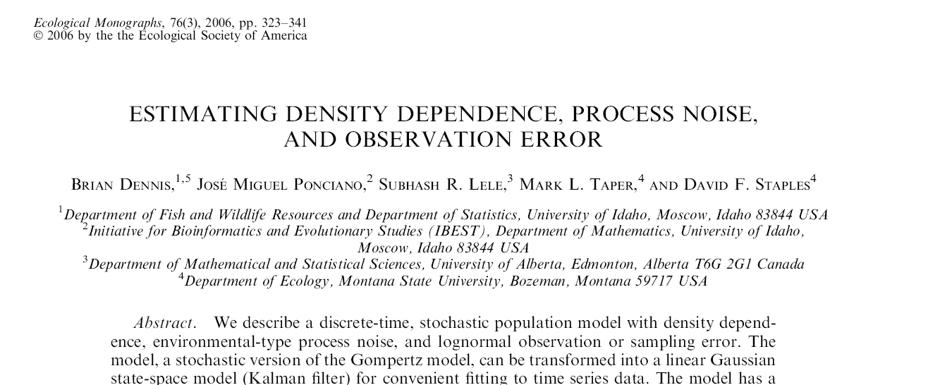
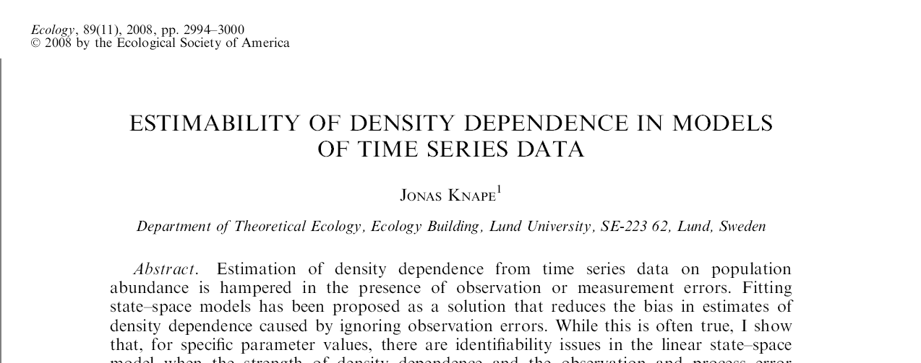
Estimating R matrix is not so easy, but replication helps A LOT
MARSS models (however you fit them) allow you to easily incorporate replication.

Slide 17
Estimation much easier if you can assume that your data are a sample from the stochastic equilibrium
Process has reached
equilibrium

Slide 18
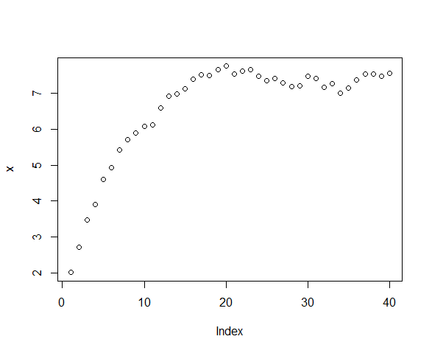
We need to be careful if the data are NON-stationary
MANY (most) fitting algorithms assume the data are drawn from the stationary distribution and thus are only applicable if your data are stationary distribution. MARSS does not assume the stationary distribution, fyi.
non-stationary
stationary

Slide 19
Parameter estimation accounting for obs error
Gompertz_example_1.R estimation technically easy..
Gompertz_example_2.R replication
Gompertz_example_3.R ML on the edge

Slide 20
Multivariate AR(1) process, “MAR1”
Note no SS part
Assume p different interacting species, then for each sp. i:
B
X_{j,t-1} is abundance of species j at time t-1
b_{ij} is effect of species j on species i
Note: when i = j, b_{ij} is effect of species i on itself

Slide 21
How to estimate b when you are willing to assume the data come from stoc. equil.?
Idea #1 Impose the constraint that
W(t)=(y(t)-y(t-1)) and
W(t)-W(t-1)
Have the variance-covariance structure of a stochastic Gompertz observed with error.
Compute Q from the total sample variance and the estimate of b

Slide 22
How to estimate b when you are willing to assume the data come from stoc. equil.?
Idea #2 If you subtract E(x(t)) then U=0
Use mean(data) as E(x(t))
Has the added value of removing “a” too!
Used in Ives et al 2003
Gompertz_example_4.R

Slide 23
Important messages
u and B are confounded. Likelihood is banana-shaped, so we need to constrain u
de-mean the data; set u=0; set tinitx=1
don’t demean data; set u=0; estimate a; set tinits=1
don’t demean data; use covariates in obs to model level
be careful in what covariates you include in the process model (you’re introducing u via Cc)
What happens when we add observation error?
Estimation is more difficult.
Replication will help us estimate R vs Q

Slide 24
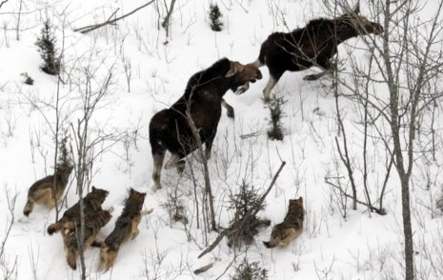
2-species: Predator-Prey
Moose
Wolf

Slide 25
MAR(1): x_{t}=Bx_{t-1} + u + w_{t}
“spp” abundance
B = interaction matrix
Process variation
MVN(0,Q)
Notes:
25
Notice diagonal is different. If diagonal is <1 then b(i,i) is negative and spp i has a negative effect on itself. NOW the variation is added

Slide 26
Meaning of the B matrix
Inter-specific effects
(can be set to zero)
Inter-specific effects
(can be set to zero)
Intra-specific effects
effect of spp i on itself,
aka density-dependence

Slide 27
Observation error causes
Spurious density-dependence, i.e. apparent stronger effect of self on self
Spuriously low species interaction strengths, i.e. apparent lower effect of other on self
Inter-specific effects
(go to 0)
Intra-specific effects
go to 0

Slide 28
Adding covariates
covariates
B = interaction matrix
covariate effect
Process variation not from covariates (“unexplained”)
Notes:
28
Notice diagonal is different. If diagonal is <1 then b(i,i) is negative and spp i has a negative effect on itself. NOW the variation is added

Slide 29
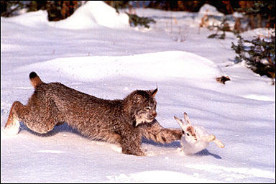
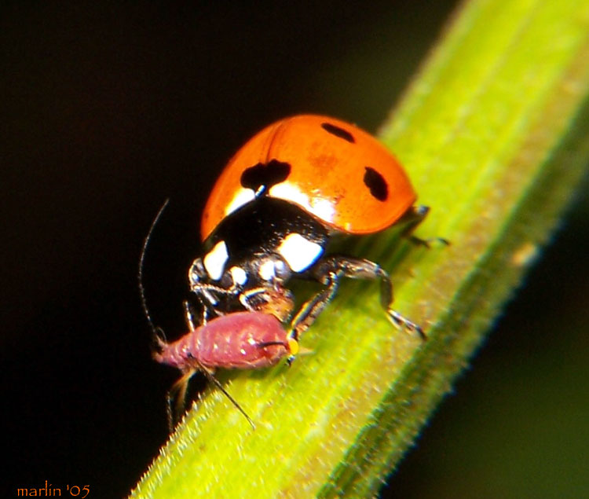
Lotka-Volterra predator-prey interactions
S. E. Hampton, NCEAS, UCSB, hampton@nceas.ucsb.edu, 7 July 2007

Slide 30
Simple 2-species system Predator & Prey
Data are simulated using a discrete time version of a Lotka-Volterra model with density-dependence in the herbivore– easy to change interaction strength
H = herbivore sp
P = predator sp.
b = herbivore birth rate
K = herbivore carrying-capacity
a = per capita attack rate
e = conversion efficiency (consumed prey turning into new predators)
s = death rate for predators
dH/dt=
bH(1 - H/K) - a H P + w_{h}
dP/dt =
e(aPH) - sP + w_{p}
S. E. Hampton, NCEAS, UCSB, hampton@nceas.ucsb.edu, 7 July 2007

Slide 31
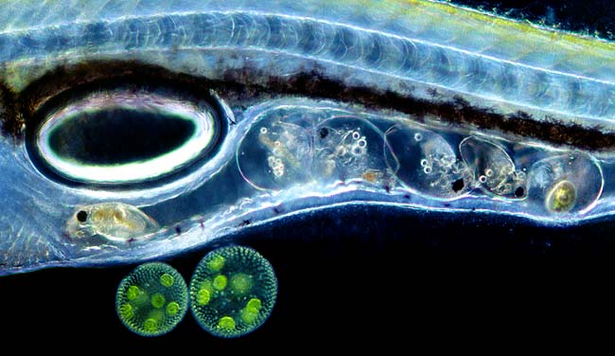
This model can display a variety of dynamics
S. E. Hampton, NCEAS, UCSB, hampton@nceas.ucsb.edu, 7 July 2007

Slide 32
Estimate strength of density-dependence and interaction strength using MARSS
LV_example_1.R
change conversion efficiency of predator
LV_example_2.R
add observation error
LV_example_3.R
covariate affects K of herbivore
LV_example_4.R
covariate affects conversion efficiency of predator

Slide 33

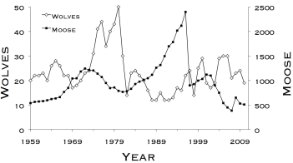
Computer lab: the moose and wolf dynamics on Isle Royale
data and images from www.isleroyalewolf.org

Slide 34
Topics
MAR(1) models as sum of community interactions
MAR(1) models as a general approximation to nonlinear systems
Stability properties of MAR(1) models
Estimating MAR(1) models
The theory in this lecture draws largely from
Ives AR, Dennis B, Cottingham KL, Carpenter SR. 2003. Estimating community stability and ecological interactions from time series data. Ecological Monographs 73: 301-330
Many ecological applications are reviewed in
Hampton, S.E., E.E. Holmes, D.E. Pendleton, L.P. Scheef, M.D. Scheuerell, and E.J. Ward. 2013. Quantifying effects of abiotic and biotic drivers on community dynamics with multivariate autoregressive (MAR) models. Ecology 94:2663-2669
Links to both are on the course syllabus

Slide 35
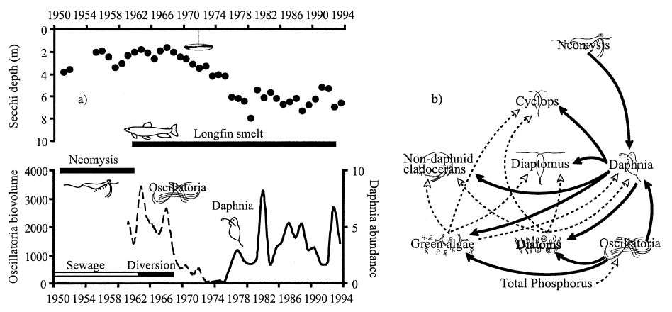
Lake Washington: a large change in sewage inputs in the late 1960s led to a dramatic change in the plankton community
Hampton et al. (2006)
Notes:
MAR(1) Workshop - ESA 2007, San Jose, CA
5 Aug 2007

Slide 36
How can we make sense of this?
Dashed lines are (+) interactions; solid lines are (-)
Hampton et al. (2006)
Notes:
MAR(1) Workshop - ESA 2007, San Jose, CA
5 Aug 2007

Slide 37
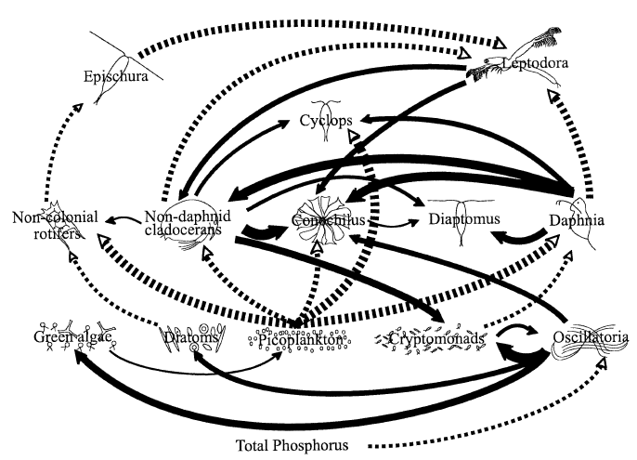
And reduce to the ‘important’ links?
Dashed lines are (+) interactions; solid lines are (-)
Hampton et al. (2006)
Notes:
MAR(1) Workshop - ESA 2007, San Jose, CA
5 Aug 2007

Slide 38
Multivariate AR(1) process, “MAR1”
Note no SS part
Assume p different interacting species, then for each sp. i:
B
X_{j,t-1} is abundance of species j at time t-1
b_{ij} is effect of species j on species i
Note: when i = j, b_{ij} is effect of species i on itself

Slide 39
Multivariate AR(1) process
Can add effects of q different environmental covariates (U):
q=2
c_{k,t} is covariate k (e.g., temperature) at time t
C_{ik} is effect of covariate k on species i
NOTE: covariate not time lagged; if you want a time-lagged covariate you need to use the time-lagged covariate as c_{t}

Slide 40
Multivariate AR(1) process
Can write all of this as:
x_{t} is p x 1 vector of species abundance at time t
u is p x 1 vector of intrinsic growth rates
B is p x p matrix of density-dependent effects
x_{t-1} is p x 1 vector of species abundance at time t-1
C is p x q matrix of covariate effects
c_{t} is q x 1 vector of covariate values at time t

Slide 41
Multivariate AR(1) process
A note on the B matrix structure:
Inter-specific effects
(can be set to zero)
Inter-specific effects
(can be set to zero)
Intra-specific effects

Slide 42
Real systems do not necessarily have log-linear density-dependence
Note: If N is not spanning very large values a linear model may suffice
Nonlinear
Linear approx.
log N_{t+1}
log N_{t+1}
log N_{t}
log N_{t}
Modern literature on MAR(1) models allow B to be time-varying which allows that linear approximation to vary in time.

Slide 43
Stationary distribution for MAR(1)
Mean vector:
Covariance matrix:
Note: cannot solve analytically this for V∞
Solution: use the Vec(•) operator
(analogous to the univariate case)

Slide 44
Stability properties of MAR(1) models
Our interest is in stable systems
(i.e. all eigenvalues of B lie within unit circle)
Stability can be measured in several ways, but here are three that we will use:
Stability measure | More stable when…
Variance | variance of the stationary distribution is low relative to that for the process error
Return rate | rapid approach to the stationary distribution (i.e. high return rate)
Reactivity | fewer departures from the mean of the stationary distribution (i.e. low reactivity)

Slide 45
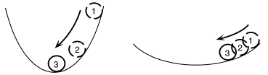
Stability properties of MAR(1) models
Return rates (ie, resilience)
In deterministic models, equilibrium is a point or stable limit cycle
In stochastic models, equilibrium is the stationary distribution
Rate of return to the stochastic equilibrium is the rate at which the transition distribution converges to the stationary distribution from an initial, known value
The more rapid the convergence, the more stable the system
More stable
Less stable
Fig. 2B - Ives et al. (2003)

Slide 46
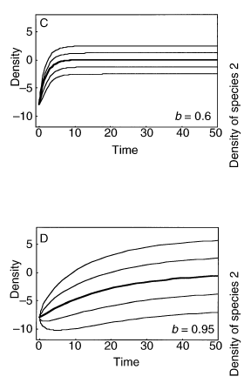
Stability properties of MAR(1) models
Return rates
Rate of return increases as |b| gets smaller
Rate of return to mean governed by dominant eigenvalue of B ≡ max(λ_{B})
Rate of return of covariance defined by dominant eigenvalue of B⊗B ≡ max(λ_{B⊗B})
Take home msg: you can write the return rate as a function of B. So if we can estimate B, we can say something about the stability of the system as measure by return rate.
Fig. 3 - Ives et al. (2003)

Slide 47
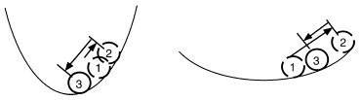
Stability properties of MAR(1) models
Reactivity
A “reactive” system moves away from a stable equilibrium following a perturbation, even though the system will eventually return to equilibrium.
Low reactivity
High reactivity
Fig. 2C - Ives et al. (2003)
High reactivity occurs when species interactions greatly amplify the environmental forcing
Not how fast does it return but how far does it go?

Slide 48
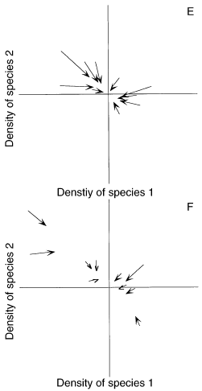
Stability properties of MAR(1) models
Reactivity
Squared Euclidian distance for X_{t-1} from μ∞
Squared Euclidian distance for X_{t} from μ∞
Change in squared Euclidian distance
Expectation of this difference
Fig. 3 - Ives et al. (2003)
“worst-case” scenario
Another form of reactivity is given in Neubert et al. (2009)

Slide 49
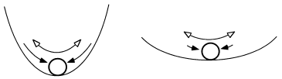
Stability properties of MAR(1) models
Variance comparison
Generally interested in the time spent away from equilibrium
More time → greater variance
More stable
Less stable
Fig. 2A - Ives et al. (2003)
Combines properties of both return rate and reactivity

Slide 50
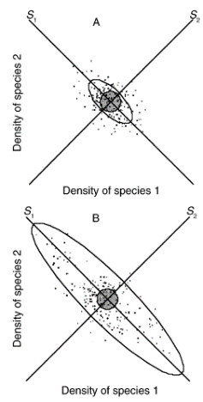
Stability properties of MAR(1) models
Variance comparison
1)
Smaller λ → smaller υ → more stable
2)
To standardize across various systems
Smaller λ → smaller det(B)^{2/p} → more stable
Fig. 3 - Ives et al. (2003)

Slide 51
MAR(1) parameter estimation
Maximum likelihood estimation (MLE)
Goal: find the B and C, that maximize the likelihood conditioned on the observed data.
Pro: does not require the assumption of no observation error (we can add an observation process) and allows missing values.
Con: Slow.

Slide 52
MAR(1) parameter estimation
dat=“some m x T matrix of log species abundances”
mod.list = list(
B=“unconstrained”,
U=“zero”,
Q=“diagonal and unequal”,
Z=“identity”,
A=“zero”,
R=“zero”,
C=“unconstrained”, c=“some q x T matrix of covariates”,
x0=dat[,1,drop=FALSE], tinitx=1
)
MARSS(dat, model=mod.list)
maximum-likelihood estimation via Expectation-Maximization algorithm or method=“BFGS” to use optim() and a quasi-Newton method.
Notes:
MAR(1) Workshop - ESA 2007, San Jose, CA
5 Aug 2007

Slide 53
Goal is to find a simpler system to explain the observed species changes
13 x 13 B matrix
Compare model support of models with different B’s set to zero
156 non-diagonal B terms. There are approximately 1e+47 (that’s 1 followed by 47 zeros) unique B matrices with different 0s.
We cannot do a brute force fitting of all models.
We should try to set some of those Bs to 0 via prior knowledge about the system
We need a fast estimation algorithm
Notes:
MAR(1) Workshop - ESA 2007, San Jose, CA
5 Aug 2007

Slide 54
Much faster MAR(1) parameter estimation
Conditional least squares (CLS)
The CLS parameter estimates are those values that minimize the squared difference between
the observed log population abundances at time t, and
those predicted by the MAR(1) model, conditional on the log population abundances at time t-1.
Requires the assumption of no observation error and no missing values allowed.

Slide 55
Conditional least squares (CLS)
m x (T-1)
(m x 1)(1 x T-1)
m x q
m x (T-1)
q x (T-1)
m x m
We work row by row through the equation and solve for each row of u, B and C.
1 x (T-1)
(T-1) x 1
1 x (T-1)
Row i: find
where
^
Let
and
^
then
Note Ives et al. 2003 writes this transposed.

Slide 56
MAR(1) parameter estimation
Conditional least squares (CLS)
There are a couple of advantages to solving this via CLS:
It’s VERY fast, and
It’s easy to zero out elements of B to “test” for their significance

Slide 57
MAR(1) parameter estimation
Conditional least squares (CLS)
There are a couple of advantages to solving this via CLS:
It’s VERY fast, and
It’s easy to zero out elements of B to “test” for their significance

Slide 58
MAR(1) parameter estimation
General steps to a MAR(1) analysis
Look at the data. Hopefully it looks like a mean-reverting process.
Deal with issues like seasonality and trends (look at papers to study how other have done this....)
Demean and standardize the variance of log population size and covariates
Impose biological constraints. “zooplankton are not affected by nitrogen”, “fish do not eat green algae”
Model selection for the B matrix

Slide 59
Search strategy for large model spaces
Best of 100 random search
100 models are generated by randomly including (50/50) each b element.
Best model (lowest AIC or BIC) is saved
Repeat 100 times to get a set of 100 “best” model.
Remove any variables that appears in less than 15 of the 100 best models.
Repeat the ‘Best of 100’ search (steps 1-3) with the new smaller set of variables.
Repeat steps 1-5 until number of variables in the 100 best is stable and chose best model.

Slide 60
Search strategy for large model spaces
Exhaustive via “leap and bound” algorithm
Algorithms to find best model over all possible variable combinations without actually doing exhaustive search.
Forward step-wise
Start with no off-diagonal b.
Add the b that most improves (reduces) model AIC
Stop at some step-AIC threshold
Backward step-wise
Same as forward but start with full model (all b’s)

Slide 61
Model diagnostics
Once selected, a MAR(1) model should be scrutinized
Useful diagnostics include:
Are residuals temporally autocorrelated (via ACF)?
Are mean or variance of the residuals correlated with any variates or covariates (via X-Y plots)?
Are residuals normally distributed (via normal probability plots)?
What proportion of the variance is explained by the model (via conditional R²)?
Note: conditional R² measures the proportion of change in log density from time t-1 to t

Slide 62
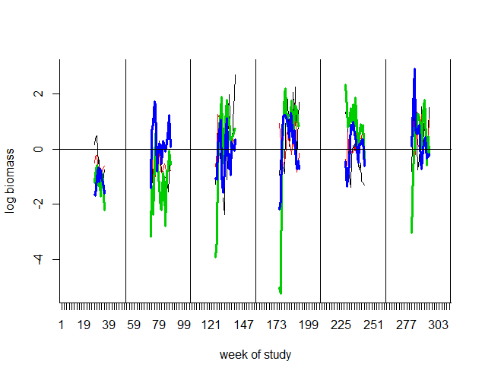
Model diagnostics
Example of demeaned plankton data, 4 spp (Ives et al 2003)
we are fitting one B matrix (and u)
so level changes need to be explained by the covariates

Slide 63
Parameter confidence intervals (CI)
Can obtain CI’s from model in 3 ways:
“Innovations” bootstrapping (how Ives et al (2003) does it)
Parameter estimation produces state residuals (w_{t})
Randomly resample the residuals (by column) to produce a new X (meaning use as your w_{t})
Use new X to again estimate parameters
Repeat “many” times
Estimate CI’s from distribution of parameter estimates

Slide 64
Parameter confidence intervals (CI)
Parametric bootstrapping if you use a MLE method
Generate parametric bootstrap data from the MLE model
Use new data to again estimate parameters (bootstrap parameter estimates)
Repeat “many” times

Slide 65
Parameter confidence intervals (CI)
3) Estimate CI’s from the (estimated) distribution of parameter estimates
Estimate the Hessian matrix (there are various R functions to do this)
Use that to compute the (estimated) CIs
Large-n approximation

Slide 66
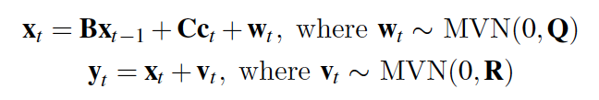
MAR(1) with observation error
This is simply our (now) familiar MARSS model:

Slide 67
See the MARSS User Guide for a computer lab that walks through
Fit community interaction model to freshwater plankton data from Ives et al. (2003)
Add covariates to the above model
Add an additional covariate (fish) observed with error
Compute stability metrics
MAR1 package on CRAN will apply the Ives et al 2003 algorithms to data sets.

